Slide 1

BCSE404L - Internet and Web Programming
Project - Books Recommendation System
RIA KABRA (21BCE1711)
NAMRA NOMAN (21BCE1681)
SHIVANGI SHUKLA (21BCE1227)
PRANAV SINGHAL (21BCE1211)

Slide 2

Index
Software technologies used
Overall design of the problem
Contribution of each member
Future work

Slide 3
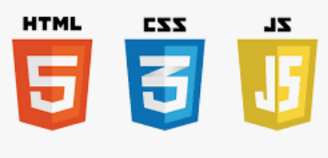
Software Technologies Used
HTML
CSS
JavaScript
ReactJs

Slide 4
Overall Design of the Problem
What is a books recommendation system?
It is a website that suggests users books based on their preferences and choices. It is a dynamic website, which gives recommendations in real time. It helps users’ build their portfolio and enhance their reading experiences. Useful for users to keep a track of types of books they read and find similarities between them, how to choose the next book based on this tool.

Slide 5
Our Design- We have built a Website using HTML as the backbone for the basic structure. The styling - colours, sizes, animations, images, etc are embedded through CSS. JavaScript is used to store the user preferences and provide them with recommendations. Performs Validations, Registrations, Updates, etc.
Uses various web pages linked to another.
First page, is the home page where the main idea behind the website is displayed. Based on various options provided, users will be navigated to login page, then their custom profile or the books store page.
The bottom of the page will contain the contact details and email id, or any social media handles for queries.

Slide 6
Contribution of each member
Ria Kabra - Document , Logic Developer
Namra Noman - Program Developer, Team Lead
Shivangi Shukla - Logic Developer, Program Developer
Pranav Singhal - Tester, UI Developer

Slide 7

Future Work
Utilize ReactJs to implement features and details
Add database to store important information
Create personalized user profiles (including avatars)
Suggestions to user based on a small quiz about their book genre
Chatbot (if required)

